Slide 1
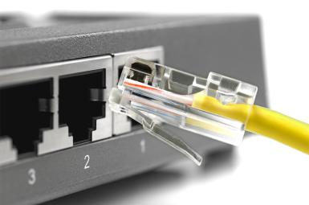
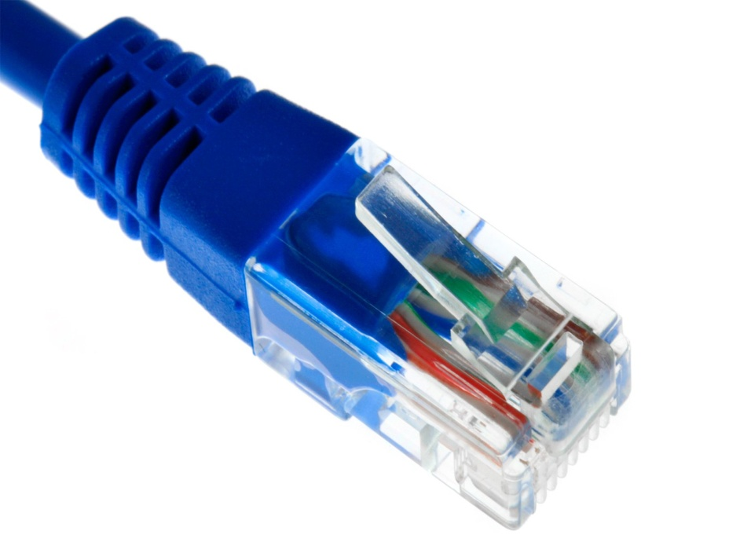
How to wire Ethernet Cables

Slide 2

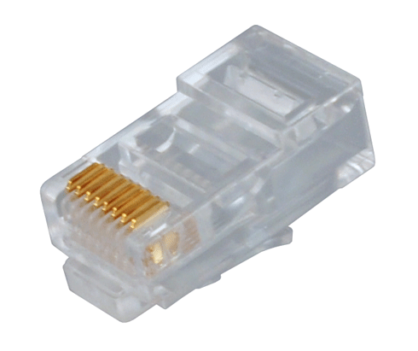

Tools Required
CAT 5 Cable - bulk Category 5, cable
RJ45 Ends
Crimper for RJ45
Wire Cutters - to cut and strip the cable if necessary
Cable Tester

Slide 3
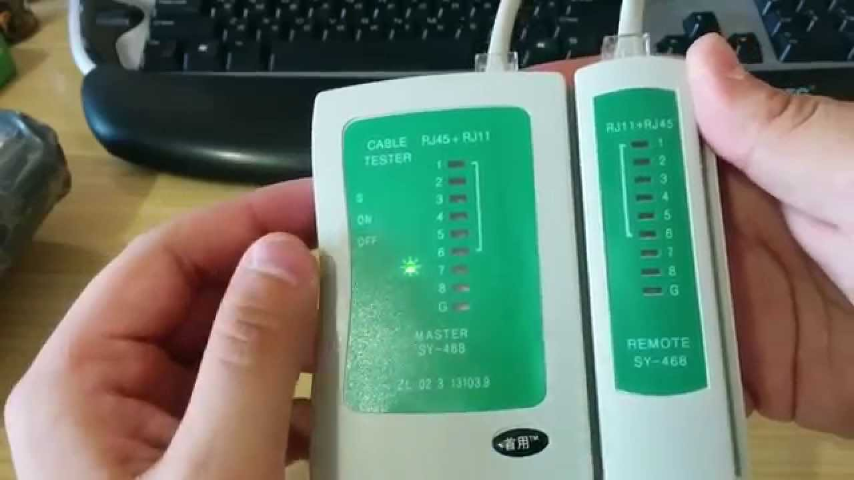
Cable Tester

Slide 4
What is an Ethernet cable?
Inside the cable, there are 8 color coded wires.
Wires are twisted into 4 pairs of wires, each pair has a common color theme. One wire in the pair being a solid or primarily solid colored wire and the other being a primarily white wire with a colored stripe.

Slide 5
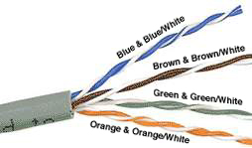
Internal Cable Structure and Color Coding
Orange / Orange-white
Green / Green-white
Blue / Blue-white
Brown / Brown-white

Slide 6
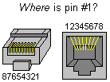
About the RJ45 Ends:
The RJ45 end is a 8-position modular connector
RJ45 Jack and Plug Pinout

Slide 7
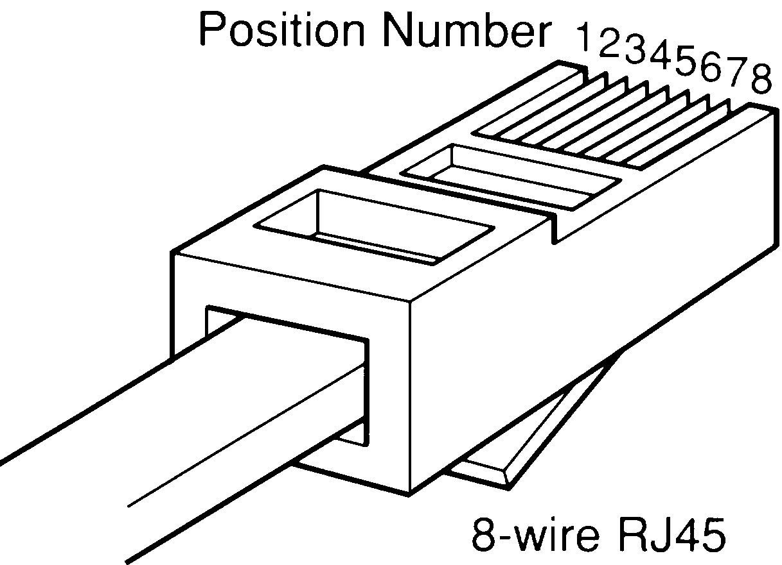

Slide 8
Ethernet Cable Pin outs:
A straight through cable
  used to connect to a hub or switch, and
A cross over cable
  used to operate in a peer-to-peer fashion without a hub/switch.
A rollover cable

Slide 9
Standard, Straight-Through Wiring (both ends are the same):
RJ45 Pin # | Wire Color | Wire Diagram | 10Base-T Signal 100Base-TX Signal | 1000Base-T Signal
1 | White/Green |  | Transmit+ | BI_DA+
2 | Green |  | Transmit- | BI_DA-
3 | White/Orange |  | Receive+ | BI_DB+
4 | Blue |  | Unused | BI_DC+
5 | White/Blue |  | Unused | BI_DC-
6 | Orange |  | Receive- | BI_DB-
7 | White/Brown |  | Unused | BI_DD+
8 | Brown |  | Unused | BI_DD-

Slide 10
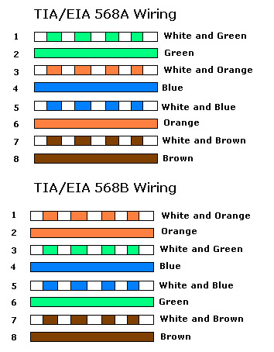
Straight Through Standard

Slide 11
Cross Over Cable
RJ45 Pin #(End 1) | Wire Color | Wire Diagram | RJ45 Pin# (End 2) | Wire Color | Wire Diagram
1 | White/Orange |  | 1 | White/Green
2 | Orange |  | 2 | Green
3 | White/Green |  | 3 | White/Orange
4 | Blue |  | 4 | White/Brown
5 | White/Blue |  | 5 | Brown
6 | Green |  | 6 | Orange
7 | White/Brown |  | 7 | Blue
8 | Brown |  | 8 | White/Blue

Slide 12
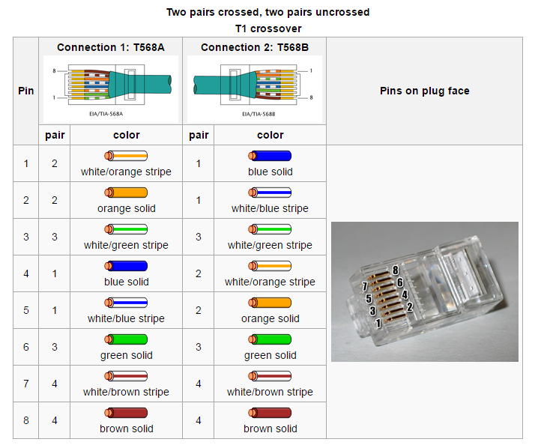
Cross Over Cable

Slide 13
How to wire Ethernet Cables:
Strip off about 2 inches of the cable sheath.
Untwist the pairs - don't untwist them beyond what you have exposed
Align the colored wires according to the diagrams above.
Trim all the wires to the same length, about 1/2" to 3/4" left exposed from the sheath.

Slide 14
How to wire Ethernet Cables:
Insert the wires into the RJ45 end - make sure each wire is fully inserted to the front of the RJ45 end and in the correct order.
Verify the wires ended up the right order and that the wires extend to the front of the RJ45 end and make good contact with the metal contacts in the RJ45 end.
Crimp the RJ45 end with the crimper tool

Slide 15
How to wire Ethernet Cables:
Cut the cable to length - make sure it is more than long enough for your needs
Repeat the above steps for the second RJ45 end.
Use a cable tester to verify the proper connectivity of the cable.

Slide 16

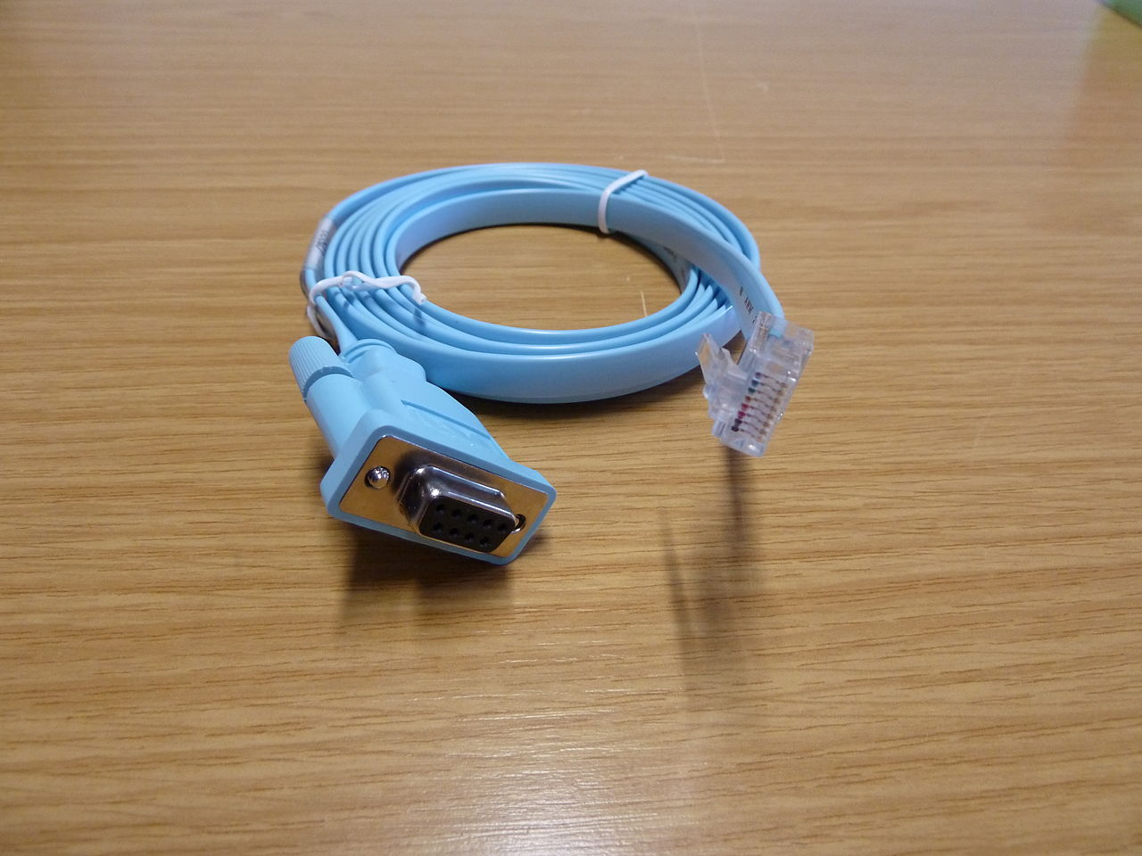
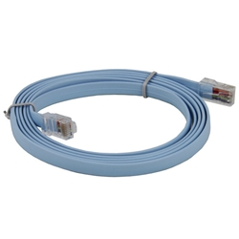
Rollover Cable

Slide 17
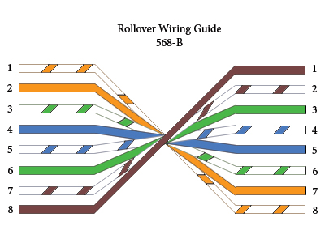
Rollover cable color code

Slide 18
~ END ~

